Slide 1

DAQuA: Difficulty-Aware Question Answering
Akshay Sharma, Nishant Raj, Dhruv Agarwal
Industry Mentor: Manzil Zaheer
PhD Mentor: Dung Thai

Slide 2


Document corpus
Notes:
I’ll start with briefly describing our problem setup. We make only the weak assumption of the availability of a corpus of textual documents.

Slide 3
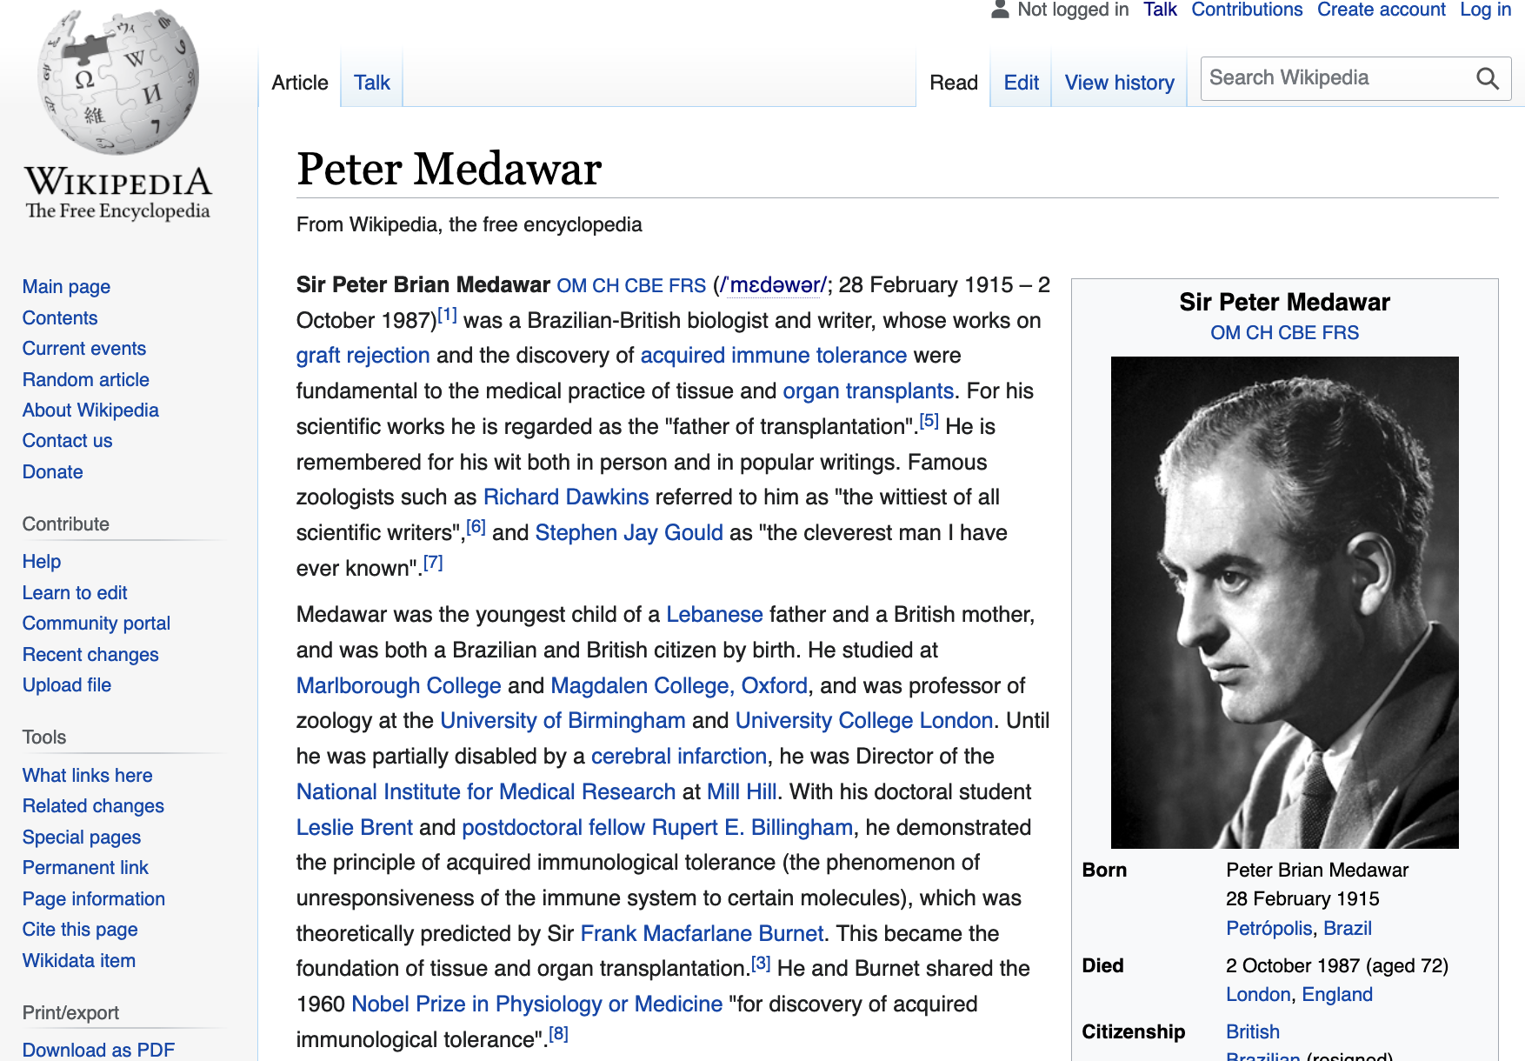
Notes:
Where each document can be thought of as a page on Wikipedia.

Slide 4

Document
Notes:
We denote all textual content on a page as the document d.

Slide 5

Document
Passage
Notes:
Each paragraph is denoted as a passage p. This may either be a natural paragraph from the page or a fixed-length sequence of tokens.

Slide 6

Document
Passage
Phrase
Notes:
And the lowest level of granularity is called a Phrase, denoted as a span of contiguous tokens s. Phrases represent sequence of words that may be used to answer short natural language questions.

Slide 7
Task Description
Notes:
With these definitions in mind, we formalize our task

Slide 8
Task Description
Given a corpus of text documents D and a natural language query Q, find a span of text s in D that best answers Q.
Notes:
Given a corpus of text documents and a natural language query, we want to find a span of text or a phrase in the set of documents that exactly answers the question.

Slide 9
Task Description
Given a corpus of text documents D and a natural language query Q, find a span of text s in D that best answers Q.
Extractive, Open-Domain Question-Answering
Notes:
The scope of our project, thus, is the extractive, open-domain QA setting.

Slide 10
Task Description
Given a corpus of text documents D and a natural language query Q, find a span of text s in D that best answers Q.
Extractive, Open-Domain Question-Answering with low latency
Notes:
with an additional focus on improving efficiency in order to mirror real-world QA latency requirements, for e.g. on large-scale search engines.

Slide 11
Example
Question #1
Who is the CEO of the company co-founded by Martin Eberhard?
Notes:
As a motivating example, consider the following question [read the question].

Slide 12
Example
Question #1
Who is the CEO of the company co-founded by Martin Eberhard?
??
Notes:
Without prior knowledge of this exact question composition, this presents a challenging setting to both humans and computers to extract an answer from a single position in a wikipedia page.

Slide 13
Example
Question #2
Who is the CEO of Tesla?
Notes:
Consider instead the following question. [Read the question]

Slide 14
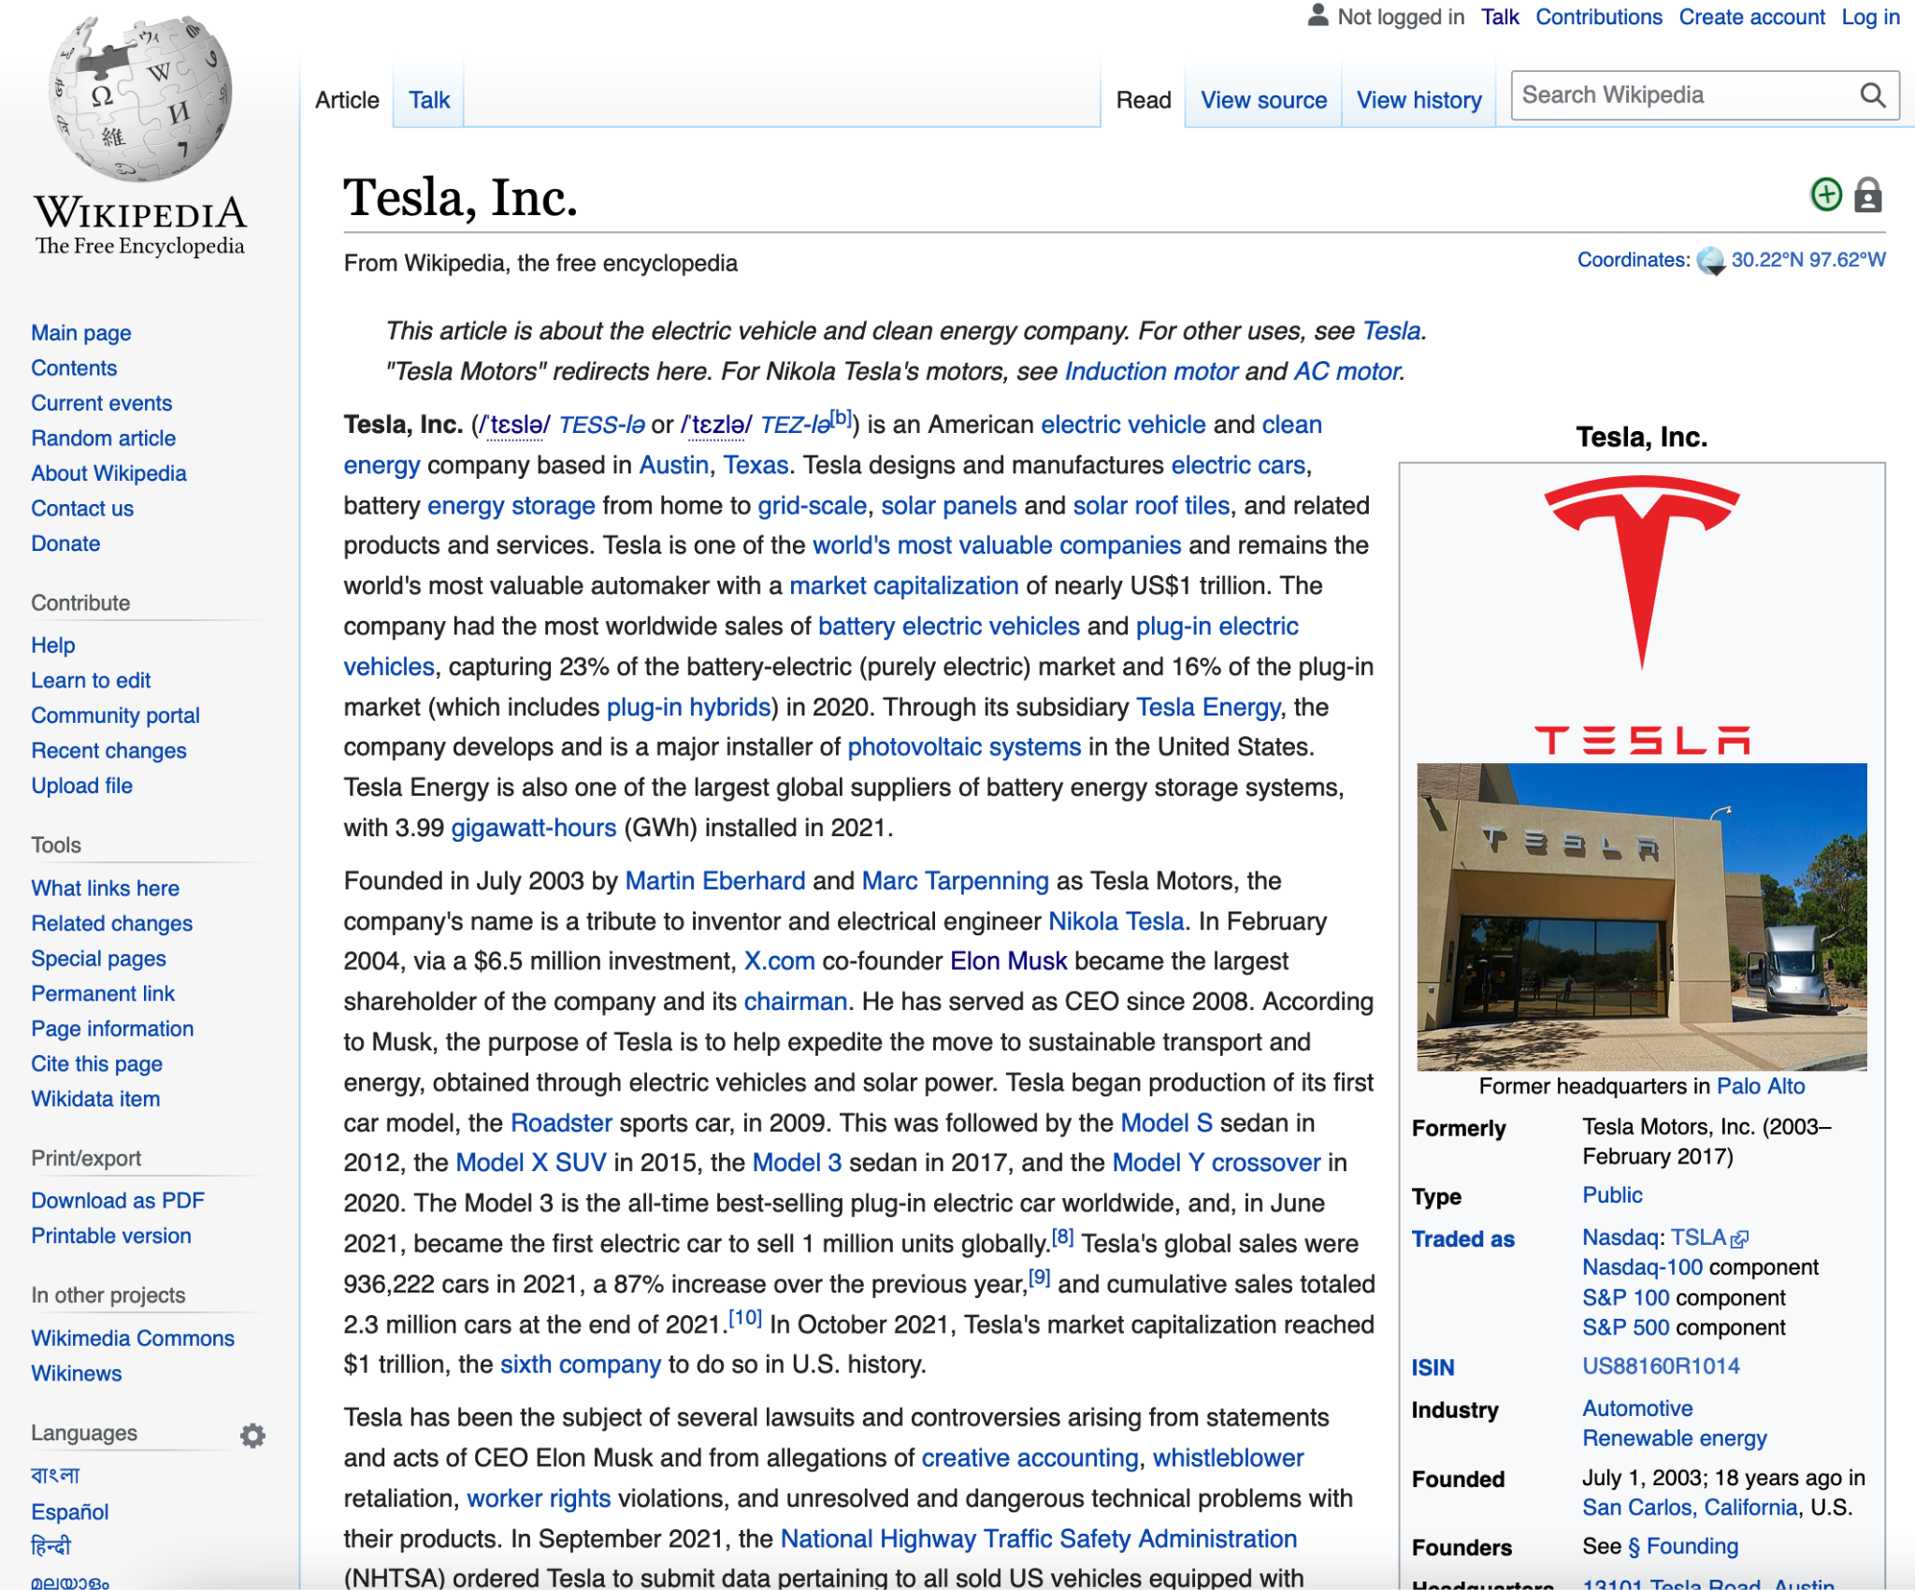
Example
Question #2
Who is the CEO of Tesla?
Notes:
Given a document about Tesla, this presents a much easier task

Slide 15
Example
Elon Musk
Question #2
Who is the CEO of Tesla?
Notes:
Since the answer span can be extracted in one go.

Slide 16
Question “Difficulty”
Question #1 Who is the CEO of the company co-founded by Martin Eberhard?
Question #2 Who is the CEO of Tesla?
Elon Musk
Notes:
This motivates our definition of the concept of question difficulty

Slide 17
Question “Difficulty” (hops)
Question #1 Who is the CEO of the company co-founded by Martin Eberhard?
Question #2 Who is the CEO of Tesla?
Elon Musk
“high” difficulty → Multi-Hop
“low” difficulty → Single-Hop
Notes:
While both questions are answered using the same span of text - Elon Musk - we observe that question 1 additionally requires the intermediate step of retrieving the name of the company mentioned in the query and only then is able to extract the final answer. Such questions require “multi-hop” reasoning over text and represent a “high” difficulty level as opposed to single-hop questions that can be answered in one-shot.

Slide 18
Motivating Question

Slide 19
Motivating Question
Can we develop a low-latency system for Question-Answering over text corpora that can answer both single- and multi-hop questions in a unified framework with adaptive compute based on question difficulty?
Notes:
This brings us to the overall motivation for our project. [Read the statement]
A successful approach will provide relevant direction for future work to tackle more realistic scenarios where the number of hops are not known a priori and system users expect fast response times.

Slide 20
Existing Work

Slide 21
Existing Work
Retriever-reader paradigm
Document / passage retrieval
Iterative dense retrieval (Xiong et al., 2021; Zhao et al., 2021)
Answer span extraction
Auxiliary information
Hyperlinks
Document structure (section / sub-section hierarchy)
Knowledge bases
Non-adaptive
Number of hops known a priori
Span “reader” required for questions of all difficulty
Phrase retrieval (Lee et al., 2021)

Slide 22
Existing Work
Retriever-reader paradigm
Document / passage retrieval
Iterative dense retrieval (Xiong et al., 2021; Zhao et al., 2021)
Answer span extraction (expensive)
Auxiliary information (strong assumptions)
Hyperlinks
Document structure (section / sub-section hierarchy)
Knowledge bases
Non-adaptive
Number of hops known a priori (unrealistic)
Span “reader” required for questions of all difficulty (redundancy)
Phrase retrieval (Lee et al., 2021) (single-hop)

Slide 23
Existing Work
DensePhrases demo (Lee et al., 2021; http://densephrases.korea.ac.kr/)
Question | Prediction | Answer Document
Who was the president of the USA in 1962? | Correct prediction | Apollo program
Who was the prime minister of India in 1962? | Correct prediction | India–Nigeria relations
Who is the chairman of Manchester United? | Correct prediction | Washington University in St. Louis

Slide 24
Existing Work
DensePhrases demo (Lee et al., 2021; http://densephrases.korea.ac.kr/)
Question | Prediction | Answer Document
Who was the president of the USA in 1962? | Correct prediction | Apollo program
Who was the prime minister of India in 1962? | Correct prediction | India–Nigeria relations
Who is the chairman of Manchester United? | Correct prediction | Washington University in St. Louis
Observations:
Multiple contexts: Answer can be mentioned in multiple documents / passages
Multiple evidence paths: Several valid hops might exist to reach the final answer

Slide 25
Research Question
What granularity of evidence retrieval (document / passage / phrase) is sufficient in order to compute a valid evidence chain?

Slide 26
Research Question
What granularity of evidence retrieval (document / passage / phrase) is sufficient in order to compute a valid evidence chain?
Hypothesis
Phrase-level evidence retrieval provides sufficient signal to compute valid evidence chains for multi-hop question-answering, thus obviating passage retrieval & reading.

Slide 27
Proposed Approach

Slide 28
Proposed Approach
Use iterative dense retrieval to perform end-to-end multi-hop QA with phrases only.
Pre-training: Compute phrase embeddings offline
Inference:
Generate question embedding and use MIPS to find top-K phrases as candidate answers / evidence
Use an adaptivity module to determine if the answer is found
If NOT FOUND: perform next-hop phrase retrieval by appending the question with evidence tokens
Terminate after a predefined hop-limit is reached
Pick the highest-scoring phrase as the final answer
“Reader” not required since each phrase is a candidate answer
Training:
Extract intermediate evidence phrases as positive training examples for multi-hop training
Fine-tune query encoder with single and multi-hop examples to maximize gold answer/evidence probability using different negative sampling strategies
Jointly train the adaptivity module (classification layer) to predict if more hops are required or not

Slide 29
Proposed Approach
Use iterative dense retrieval to perform end-to-end multi-hop QA with phrases only.
For simple questions, use fast MIPS to find the answer phrase directly.
For complex questions, use an iterative evidence retrieval and question-update procedure to predict an evidence chain with the last evidence phrase as the answer.
At each evidence retrieval step, use a classification procedure for adaptivity to determine whether more hops are required to answer the question or not.

Slide 30
Proposed Approach
Offline Indexes
Wikipedia Corpus
Dense Phrase Indexing
Final Answer Phrase
Dense Phrases Module
Query Q0
Q1: Q0 [SEP] U1
Classification Module
MIPS
Top-K Phrases
Q2: Q0 [SEP] U1 [CONT] U2
No Answer
Evidence Update Ui
Query Update Module

Slide 31
Risks & Contingencies
Risks:
Existing systems use passage retrieval. It is possible that phrase-level evidence tokens do not capture the required context for next-hop evidence retrieval.
The efficacy and efficiency of the adaptivity classification module will require evaluation.
Contingencies:
Explore a phrase-based passage retrieval + reader approach
Explore alternative adaptivity routes:
Architecture-level changes to improve BERT efficiency. For e.g., dynamic early exiting for accelerated inference, parameter sharing, etc.
Notes:
As our current approach is based on intuition and prior research results, we do anticipate a few challenges and risks. All the SOTA existing systems for Open Domain QA are based on Retrieval-Reader approach where top passages or documents are retrieved from from the corpus. It is possible that in our approach the phrase-level tokens do not capture the required surrounding context to answer the question or next hop evidence retrieval. Also, our classification layer to determine if we require next hop to answer the question is previously used with the passage embeddings so we need to experiment and evaluate its performance with phrase embeddings and see how well it works.
Contingency approaches:
Phrase based passage retrieval: Using phrase retrieval for passage retrieval + no reranking + contextual embeddings + use a Fusion In Decoder + reader to increase the context for answer extraction.
Architectural level changes: Dynamic early exiting, Using limited layers based on change in embeddings during inference, parameter sharing etc.

Slide 32
Datasets & Baselines
Datasets:
NaturalQuestions-open
SQuAD-open
HotPotQA
BeerQA (3-hop test set generalization)
Baselines:
Phrase-based:
DensePhrases (Lee et al., 2021)
Retriever-Reader:
IRRR (Qi et al., 2020)
MDR (Xiong et al., 2021)
Notes:
Natural Questions: contains real user questions issued to Google search, and answers found from Wikipedia by annotators. (Single Hop)
Squad: Reading Comprehension questions + single hop
Hotpot QA: Synthetic + 2 Hops QAs
BeerQA: Squad + Hotpot QA
Baselines:
Dense Phrases for single hop Phrase Based retrieval for single hop question answering
Iterative Retriever, Reader, and Reranker model and Multihop Dense Retrieval model for MultiHop question answering

Slide 33
Timeline (until midpoint)
Week 1: Setup boilerplate codebase (DensePhrases)
Week 2: Run single-hop evaluation on multiple datasets
Week 3-4: Implement iterative retrieval for multi-hop
Week 5: Run experiments and evaluate contingencies
Notes:
This is the high level timeline and we are planning to finish implementing our current approach before midpoint milestone. We will run a few experiments and analyze our results so that we can switch to contingency approaches if current one doesn’t go as planned.

